Slide 1
Kubernetes
Notes:
1

Slide 2
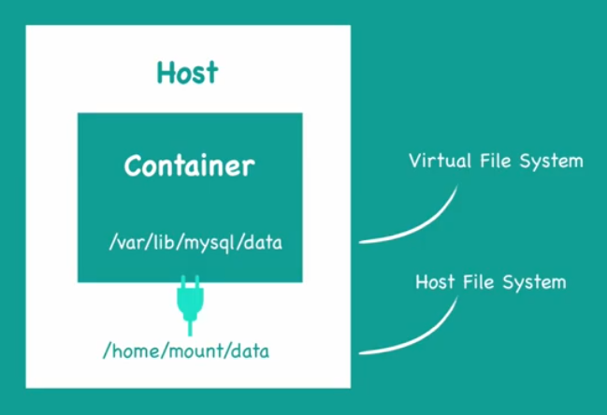
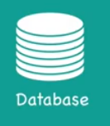
Volumes
Data persistence
Decouple the container from its storage
Share storage/data between different containers

Slide 3
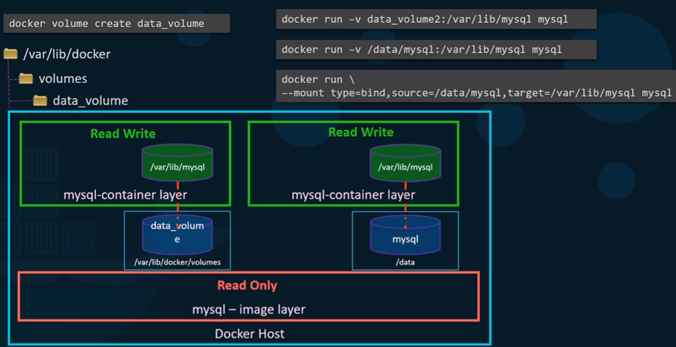
Volumes
Volume mounting
- docker default volume location
/var/lib/docker/volumes
Bind mounting
- Any location in the host

Slide 4
Volumes in Kubernetes
How can data persist through out the life cycle of a POD ?
How stateful applications (like Databases) manage the data ?
How can containers in a POD share data ?

Slide 5
Volumes in Kubernetes
Volumes bring persistence to PODs
Volumes in Kubernetes are associated with the lifecycle of a POD
Support many types of volumes

Slide 6
Types of volumes in Kubernetes
Volume Types
Ephemeral
Durable

Slide 7
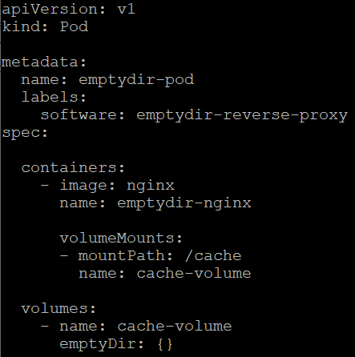
emptyDir
Creates an Empty Directory when a POD is assigned to a Node
Data stays as long as the POD is alive
emptyDir is removed when the POD is removed from the node
Use Cases: Temporary scratch space
Local Cache

Slide 8
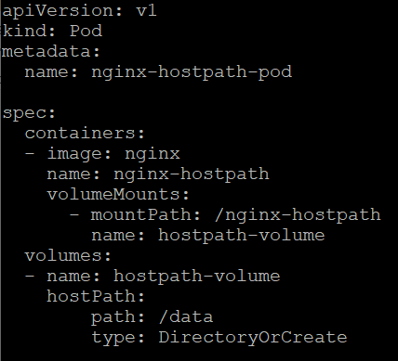
hostPath
Mounts a directory in the host’s file system into the POD
Remain even if the POD is removed

Slide 9
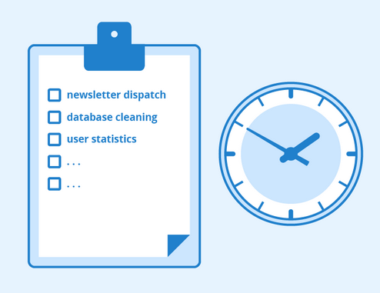
Jobs and CronJobs

Slide 10
Use cases
Large computation to perform
Repeating a task every day at scheduled time
For Exp:- Take database backup every day
Run garbage collection every hour

Slide 11
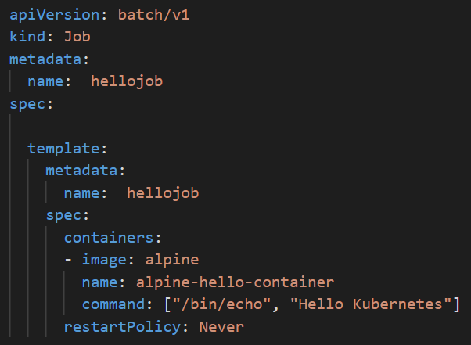
Jobs
Each Job creates one or more PODs
Ensure that POD is completed successfully
Can run multiple PODs in parallel
If a Job fail during execution, the Job Controller will restart or reschedule it

Slide 12
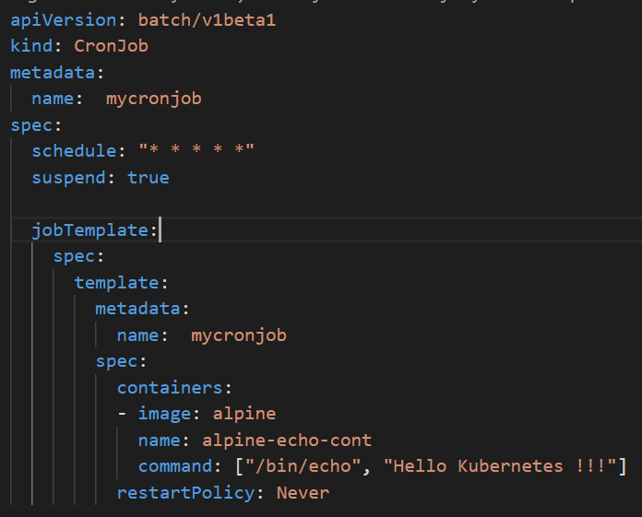
CronJob
Run jobs based on a schedule
Automated backups, synchronization with remote services and application maintenance

Slide 13
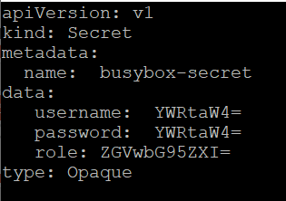
secrets
Kubernetes object that stores sensitive data safely
Exp:-
SSH keys
Database passwords
OAuth tokens
API keys
Image registry keys

Slide 14
Access secrets
Through Files Inside a Volume
Through Environment Variables

Slide 15
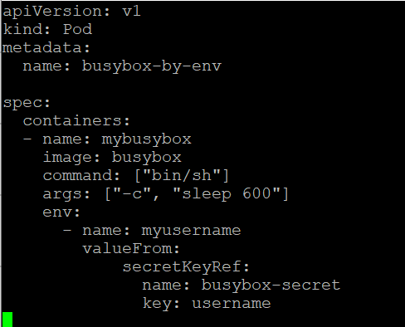
Access secrets using Environment Variables

Slide 16
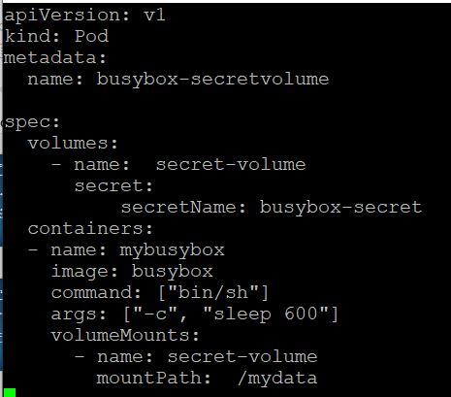
Access secrets using Volume

Slide 17
ConfigMap
Dictionary of configuration settings to manage your containerized applications
Exp: - connection strings, analytics keys, and service URLs
Helps keep your application code separate from your configuration
Improves Portability of your application

Slide 18
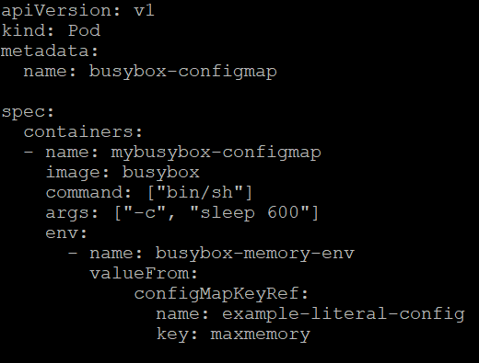
ConfigMap from Literals
kubectl create configmap example-literal-config
--from-literal=maxmemory=100MB

Slide 19
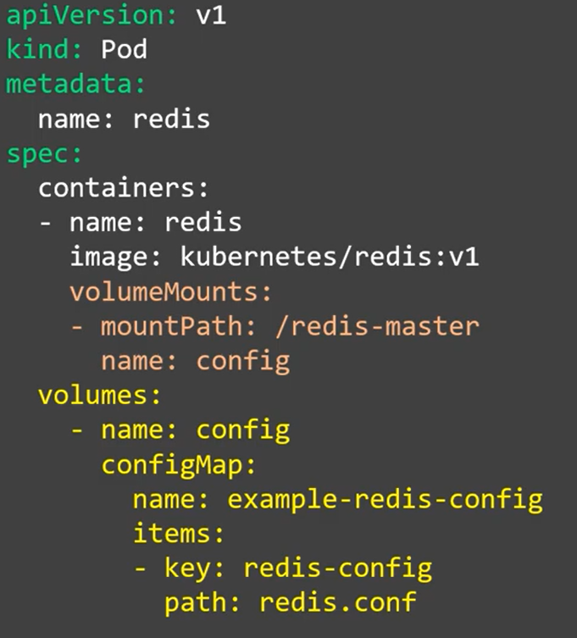
ConfigMap from file
kubectl create configmap example-redis-config
--from-file=redis-config

Slide 20
Scheduling

Slide 21
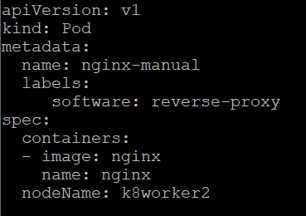
Manual Scheduling
Define nodeName property to point to the desired node in the manifest file.
If the node is not available, the POD will be moved to Pending state
Notes:
21

Slide 22
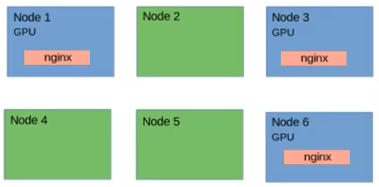
Node selector
Pod scheduling feature that allows scheduling a Pod onto a node whose labels match the nodeSelector labels specified by the user

Slide 23
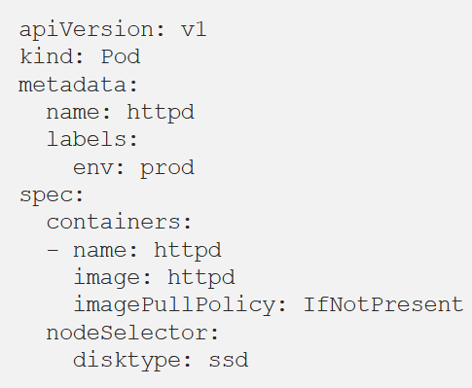
Node selector
Add a label to the Node
Exp:- kubectl label nodes host01 disktype=ssd
Define nodeSelector field in the PodSpec

Slide 24
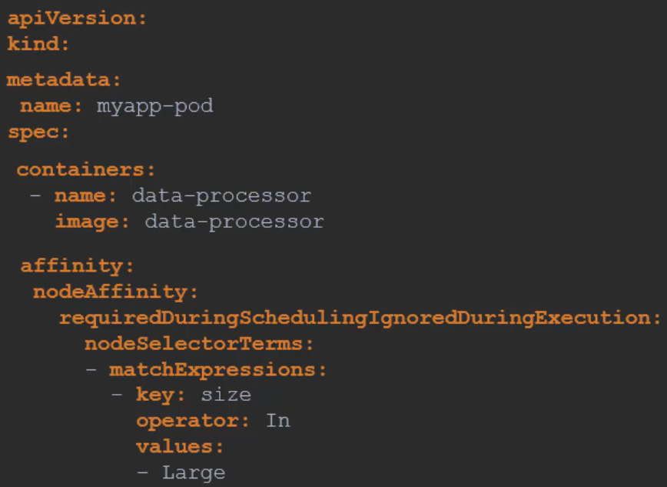
Node Affinity
Provide advanced capability to limit POD placement on specific nodes
For Exp:- OR Condition
IN, NOT IN, Exists

Slide 25
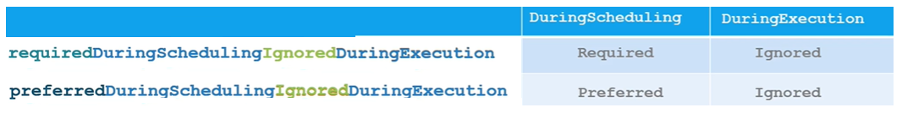
Node Affinity types

Slide 26








Taints and Tolerations
Restrict which PODs can be scheduled on which Node
Measles vaccine
Polio vaccine
Yellow Fever vaccine

Slide 27

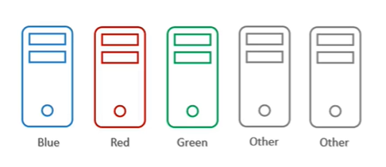
Node Affinity v/s Taints and Tolerations

Slide 28
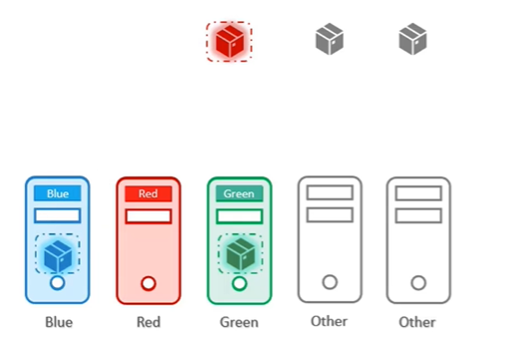
Node Affinity v/s Taints and Tolerations

